Slide 1

Web Application – Android Application
User Guide

Slide 2
WEB APPLICATION
https://www.doc.gold.ac.uk/usr/344/
GIT: https://gitlab.doc.gold.ac.uk/softproj09/medicode

Slide 3
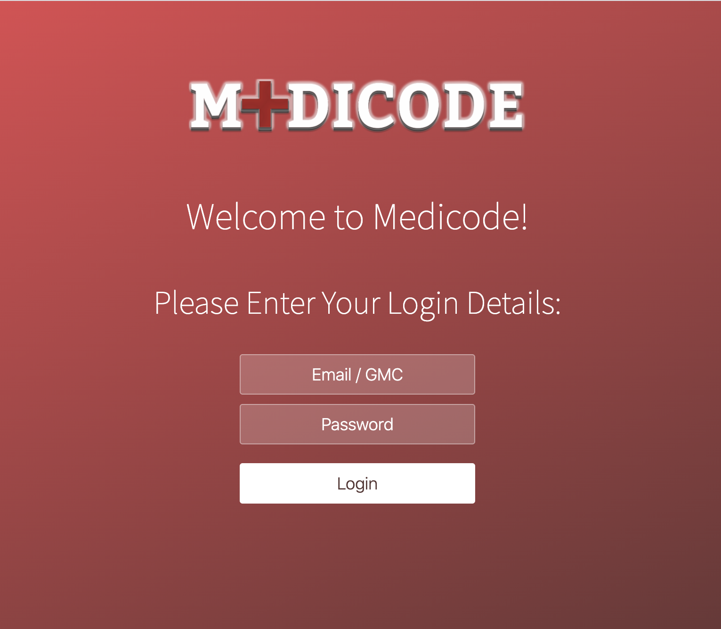
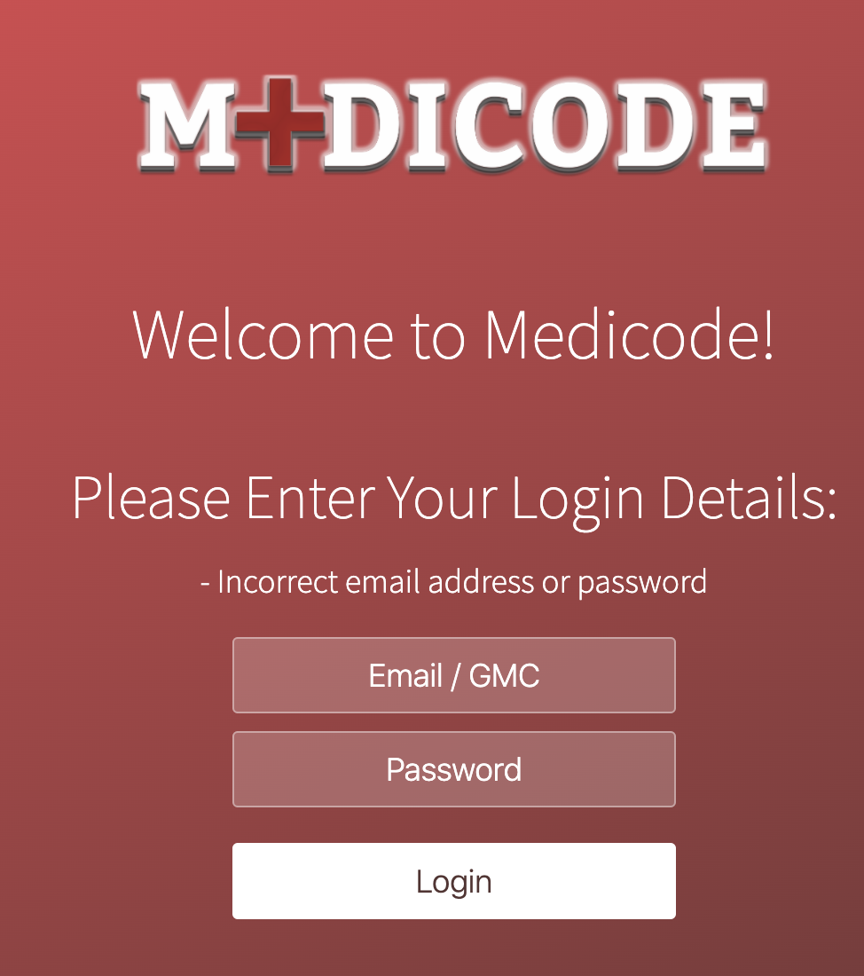
Health Care Worker Login Page
https://www.doc.gold.ac.uk/usr/344/
To access any of the pages, user must login first, otherwise it will be automatically redirected to the login page.
Health Care workers have two option to login either by using their 7-digit GMC number or their email address.
Please use this test user to login:
Email or GMC:
a.wickens@medicode.com
8313812
Password: medicode
If input does not match with the data which is stored in our database user receives an error message.

Slide 4
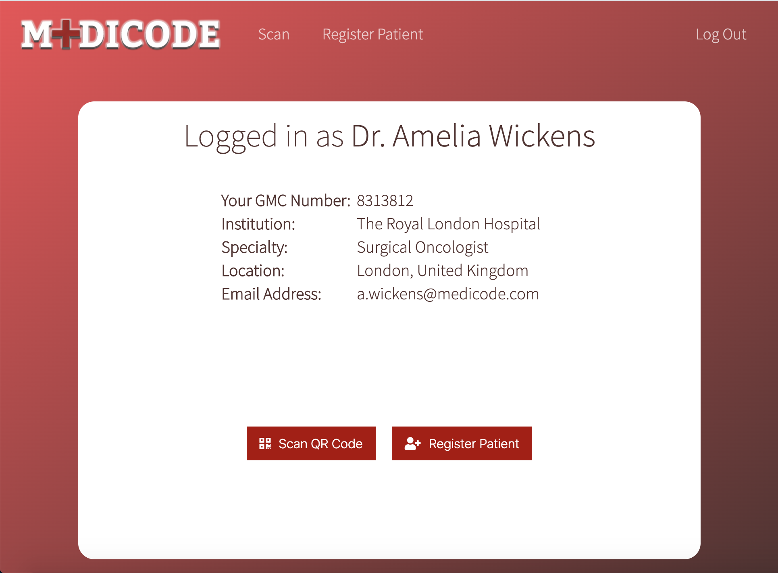

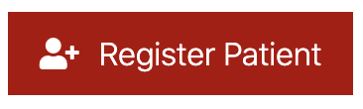

Home Page
https://www.doc.gold.ac.uk/usr/344/
After successful login, a session is created, and user is automatically redirected to the home page.
User has 3 options to do:
Go to scan page to scan a patient’s QR Code
Go to register page to register a new patient to the system
Or to log out from the application, which destroys the doctor’s session.
The heading navigation bar provides an easy navigation between these pages.

Slide 5
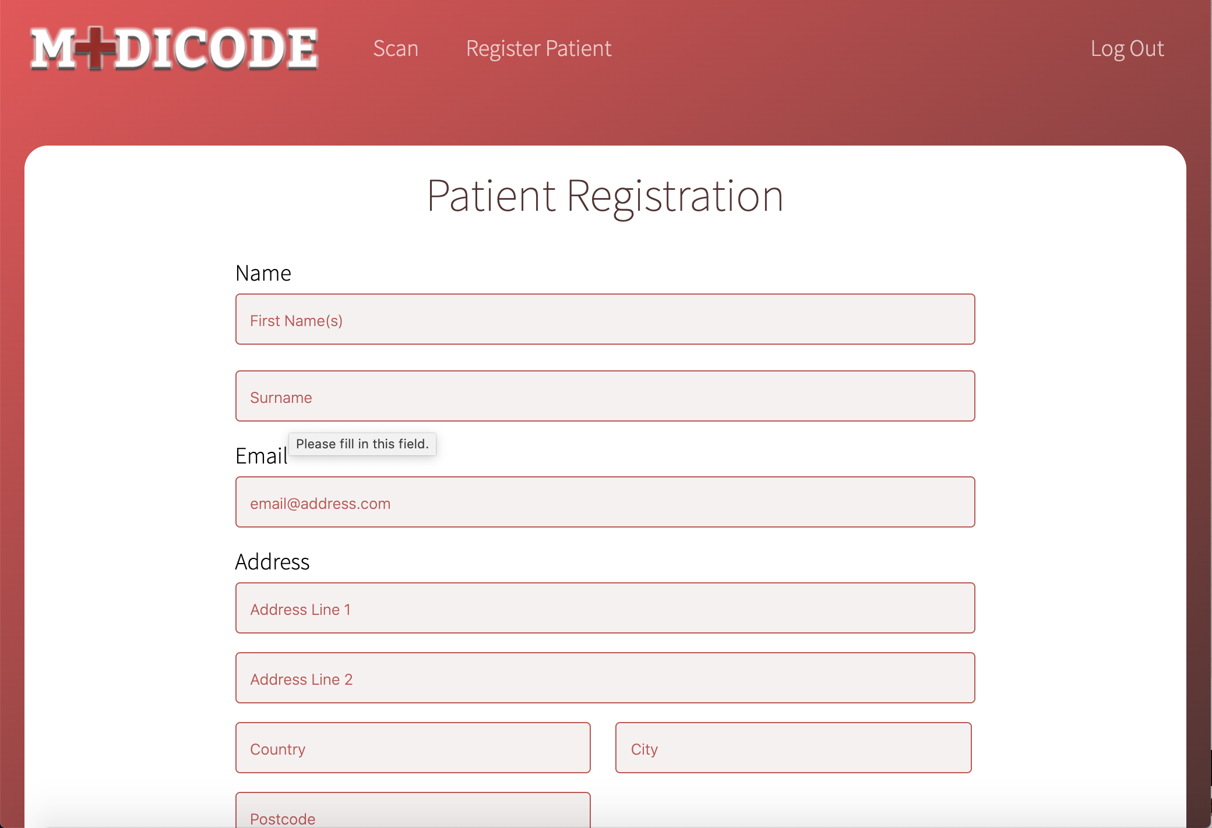
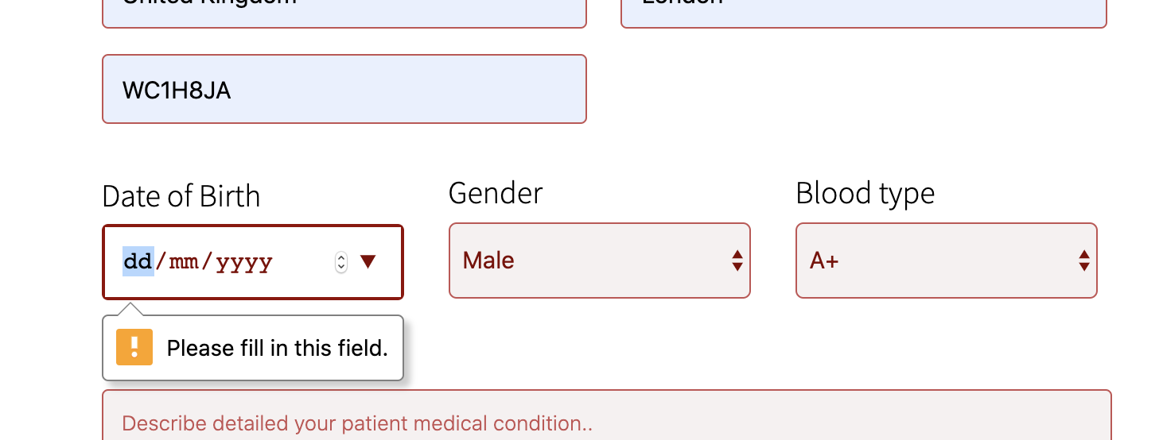
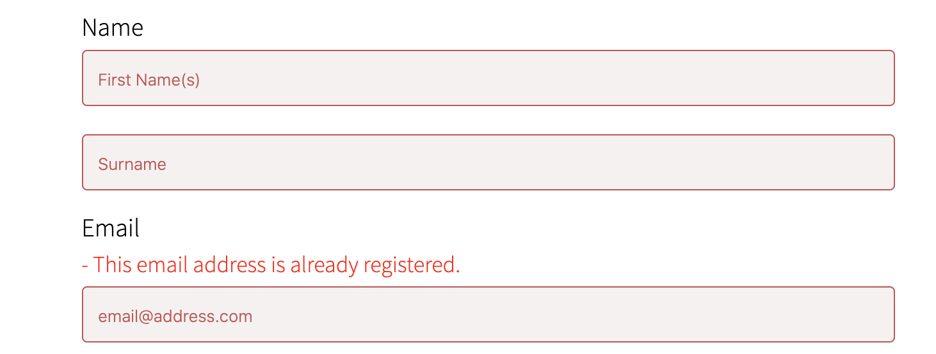
Register Patient Page
https://www.doc.gold.ac.uk/usr/344/register-patient
It is important fill up all fields to register the patient, otherwise user can not submit the form.
It is important to avoid having multiple user with the same email address, therefore if an email is already registered but the user tries to register the patient with the same email address, they receive this error message.
After successful registration patient automatically receives an email after registration, so it is important to give the correct email address. Please make sure you give an email address which you have access to, to try the functionality of this feature.
Patient’s QR code is automatically generated.

Slide 6
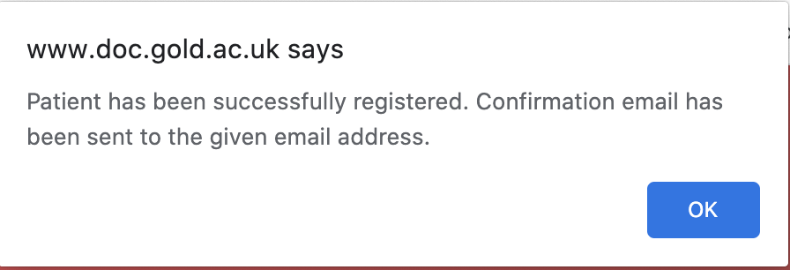
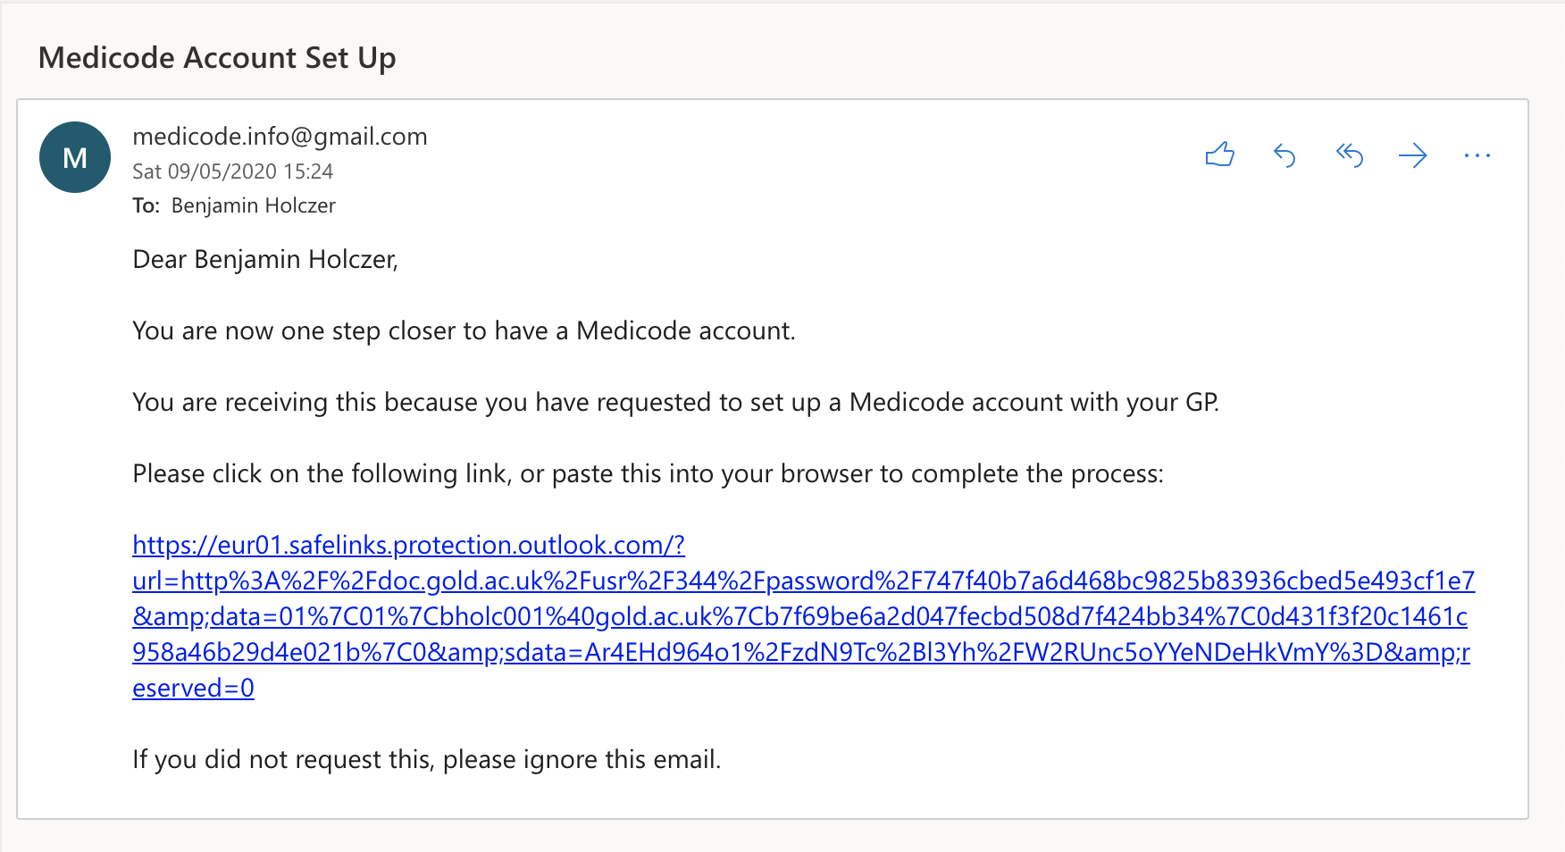
After successful registration
User Side:
The user should receive the following alert.
After they press OK, the website will redirect to home page.
Patient Side:
Patient should receive the following email.
Patient should click on the link to finish the registration.
By clicking on the link they will open the password page with their unique token.
The account set up page (password) is explained on the next slide.

Slide 7
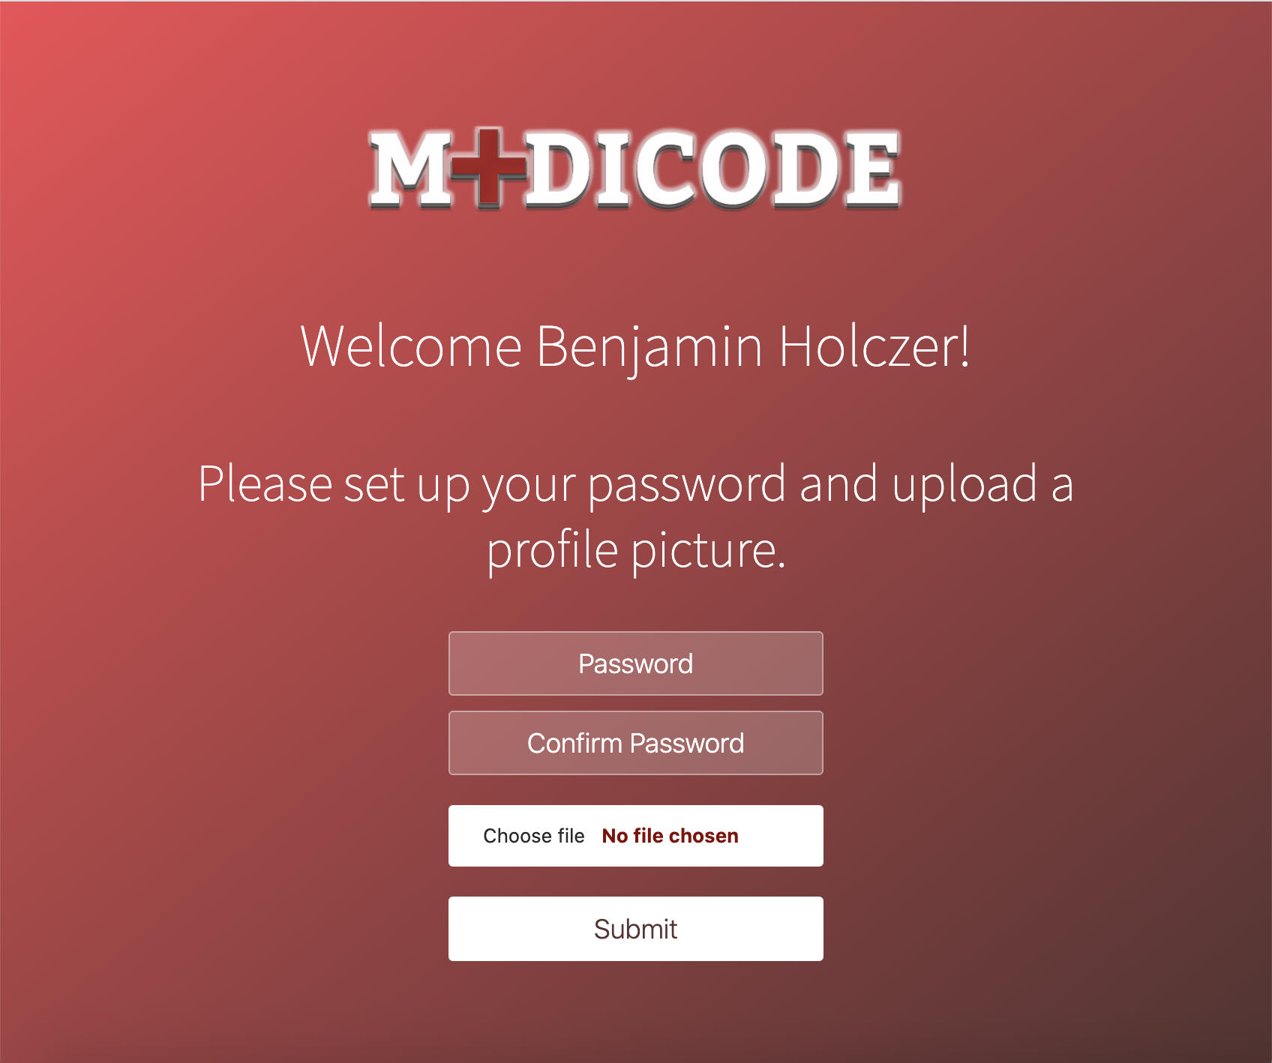
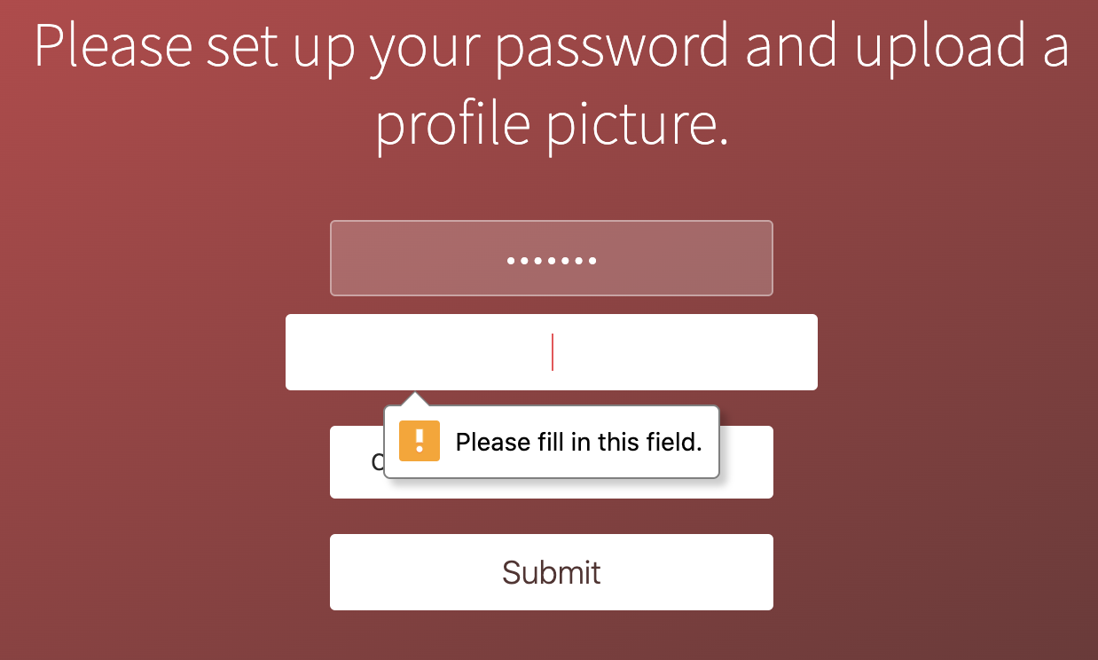
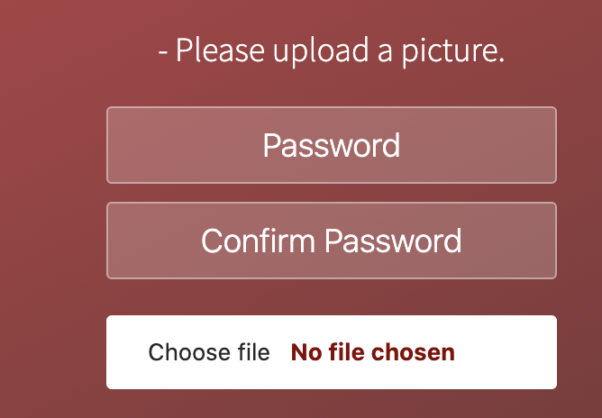

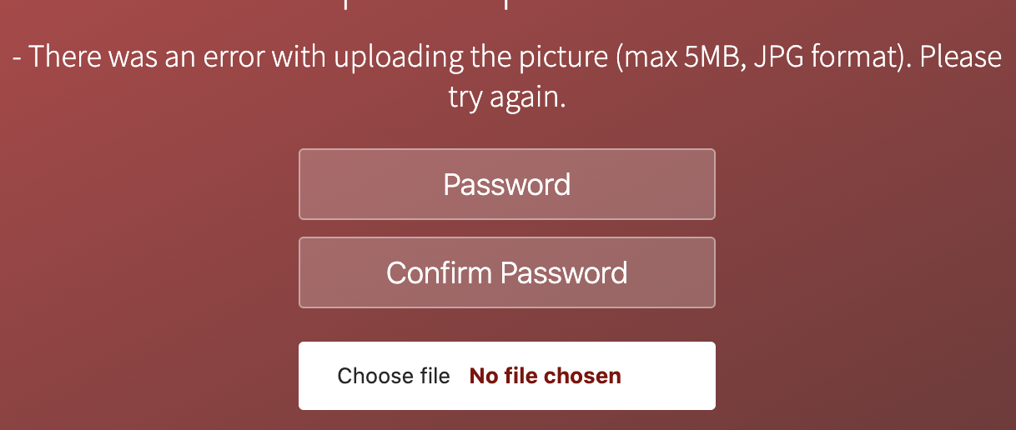
Patient Account Set Up Page
To access this page please click on the link in the email, which was sent to you automatically after registration.
Here the user must provide a password to his account and upload a profile picture.
Please enter a password longer than 5 characters and then confirm it by entering it to the confirm password field.
By clicking on the Choose file button, user must provide a profile picture to his Medicode Account.
User can receive 4 kind of error messages on this page:
If there is no password input or confirmation or the password is less than 5 characters
If passwords do not match
If user has not uploaded a picture.
If there was an error with uploading the picture, for example, file size larger than 5mb or not JPG format.

Slide 8
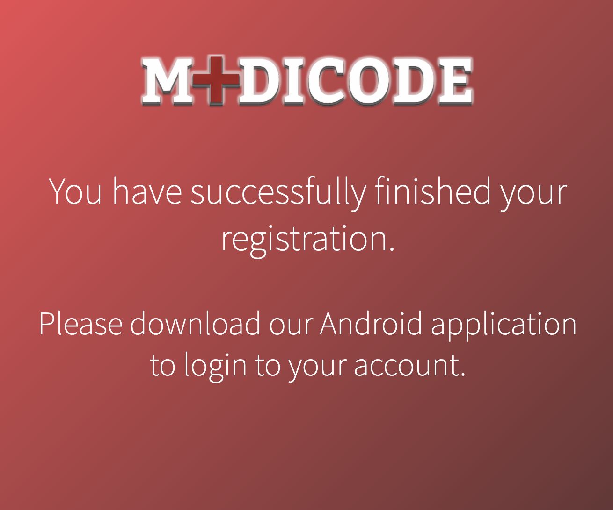
Successful Patient Account Set Up
After registration has been successfully completed the patient will receive this message
With the registered email address and with the password which has been just set up, patient user is able to login to our Android application. There will be instruction how to use our android app in one of our following slides.

Slide 9
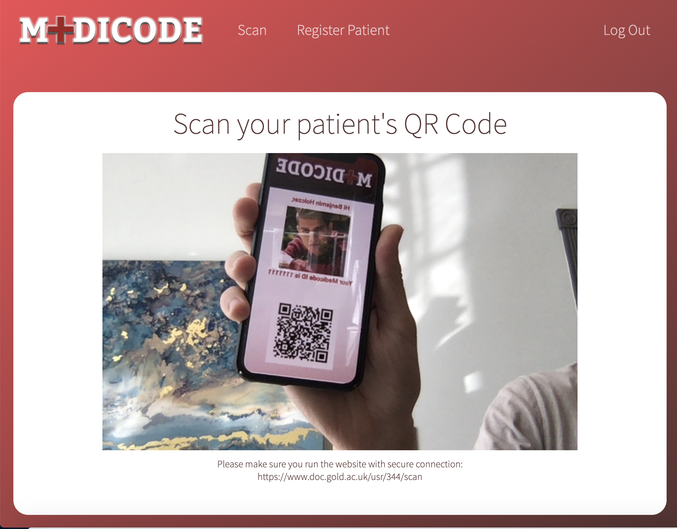
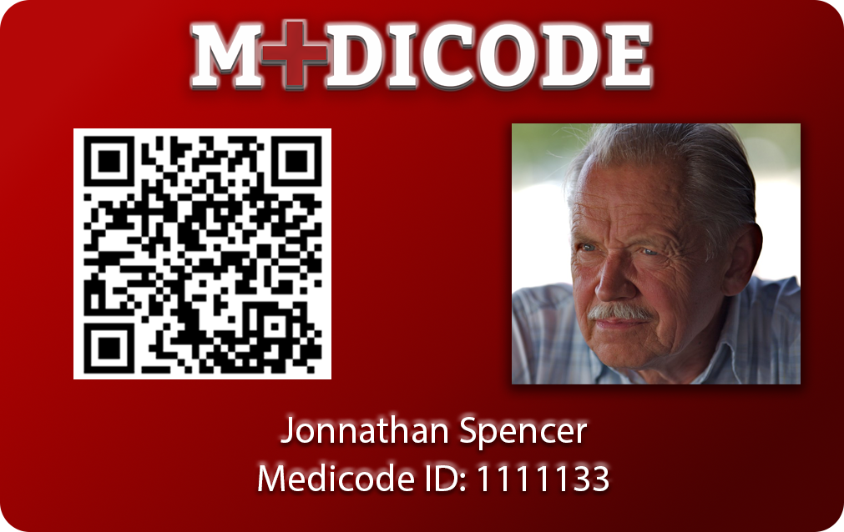
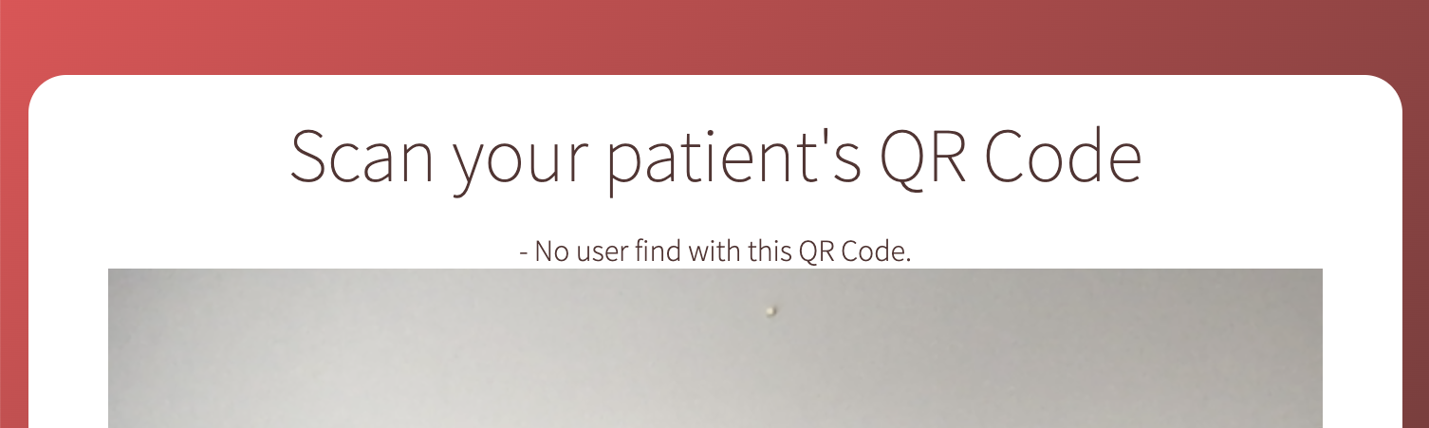
Scan Page
https://www.doc.gold.ac.uk/usr/344/scan
Please always ensure you run the page with secure connection. (https, not http), otherwise the web camera will not work.
This page is using your web camera to scan QR Code, therefore you need to allow the page to have access to your web camera.
To try out this page take a picture of this Medicode card with your phone and show it to your web camera when.
Or you can register a patient and login to our Android app where the generated QR Code will automatically appear.
The page should automatically redirect to the patient’s page and load all the data from our database
If someone tries to scan a QR code which does not exist in our database, they receive the following error message.

Slide 10
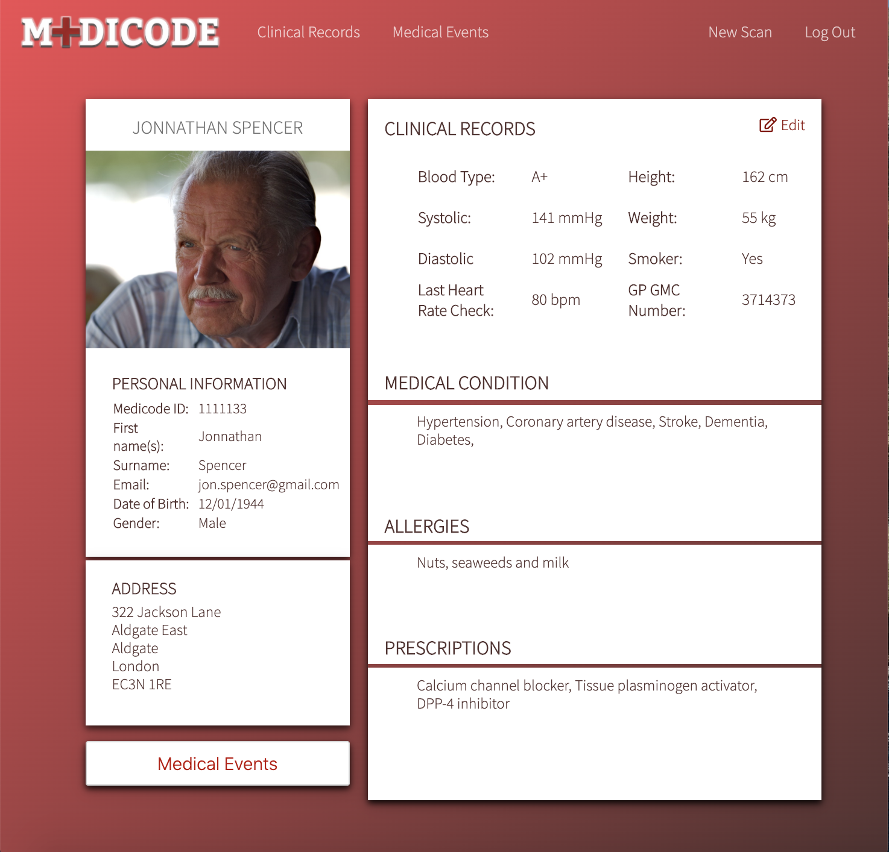

Patient Page
After patient’s QR code is scanned it automatically redirects us to patient’s page. This page can be only accessed by that.
When QR code is scanned it automatically creates another session with patient’s data. So we will have 2 sessions one for the doctor and another for the patient.
It loads all the information about the patient also the profile picture which patient has set up.
We can also see that heading navigation bar has changed and now we can navigate between Clinical Records and Medical Events.
Or we can press New Scan link which redirects us to scan page and destroys patient’s session.
Health Care workers are able to edit these details by clicking on the Edit button.

Slide 11
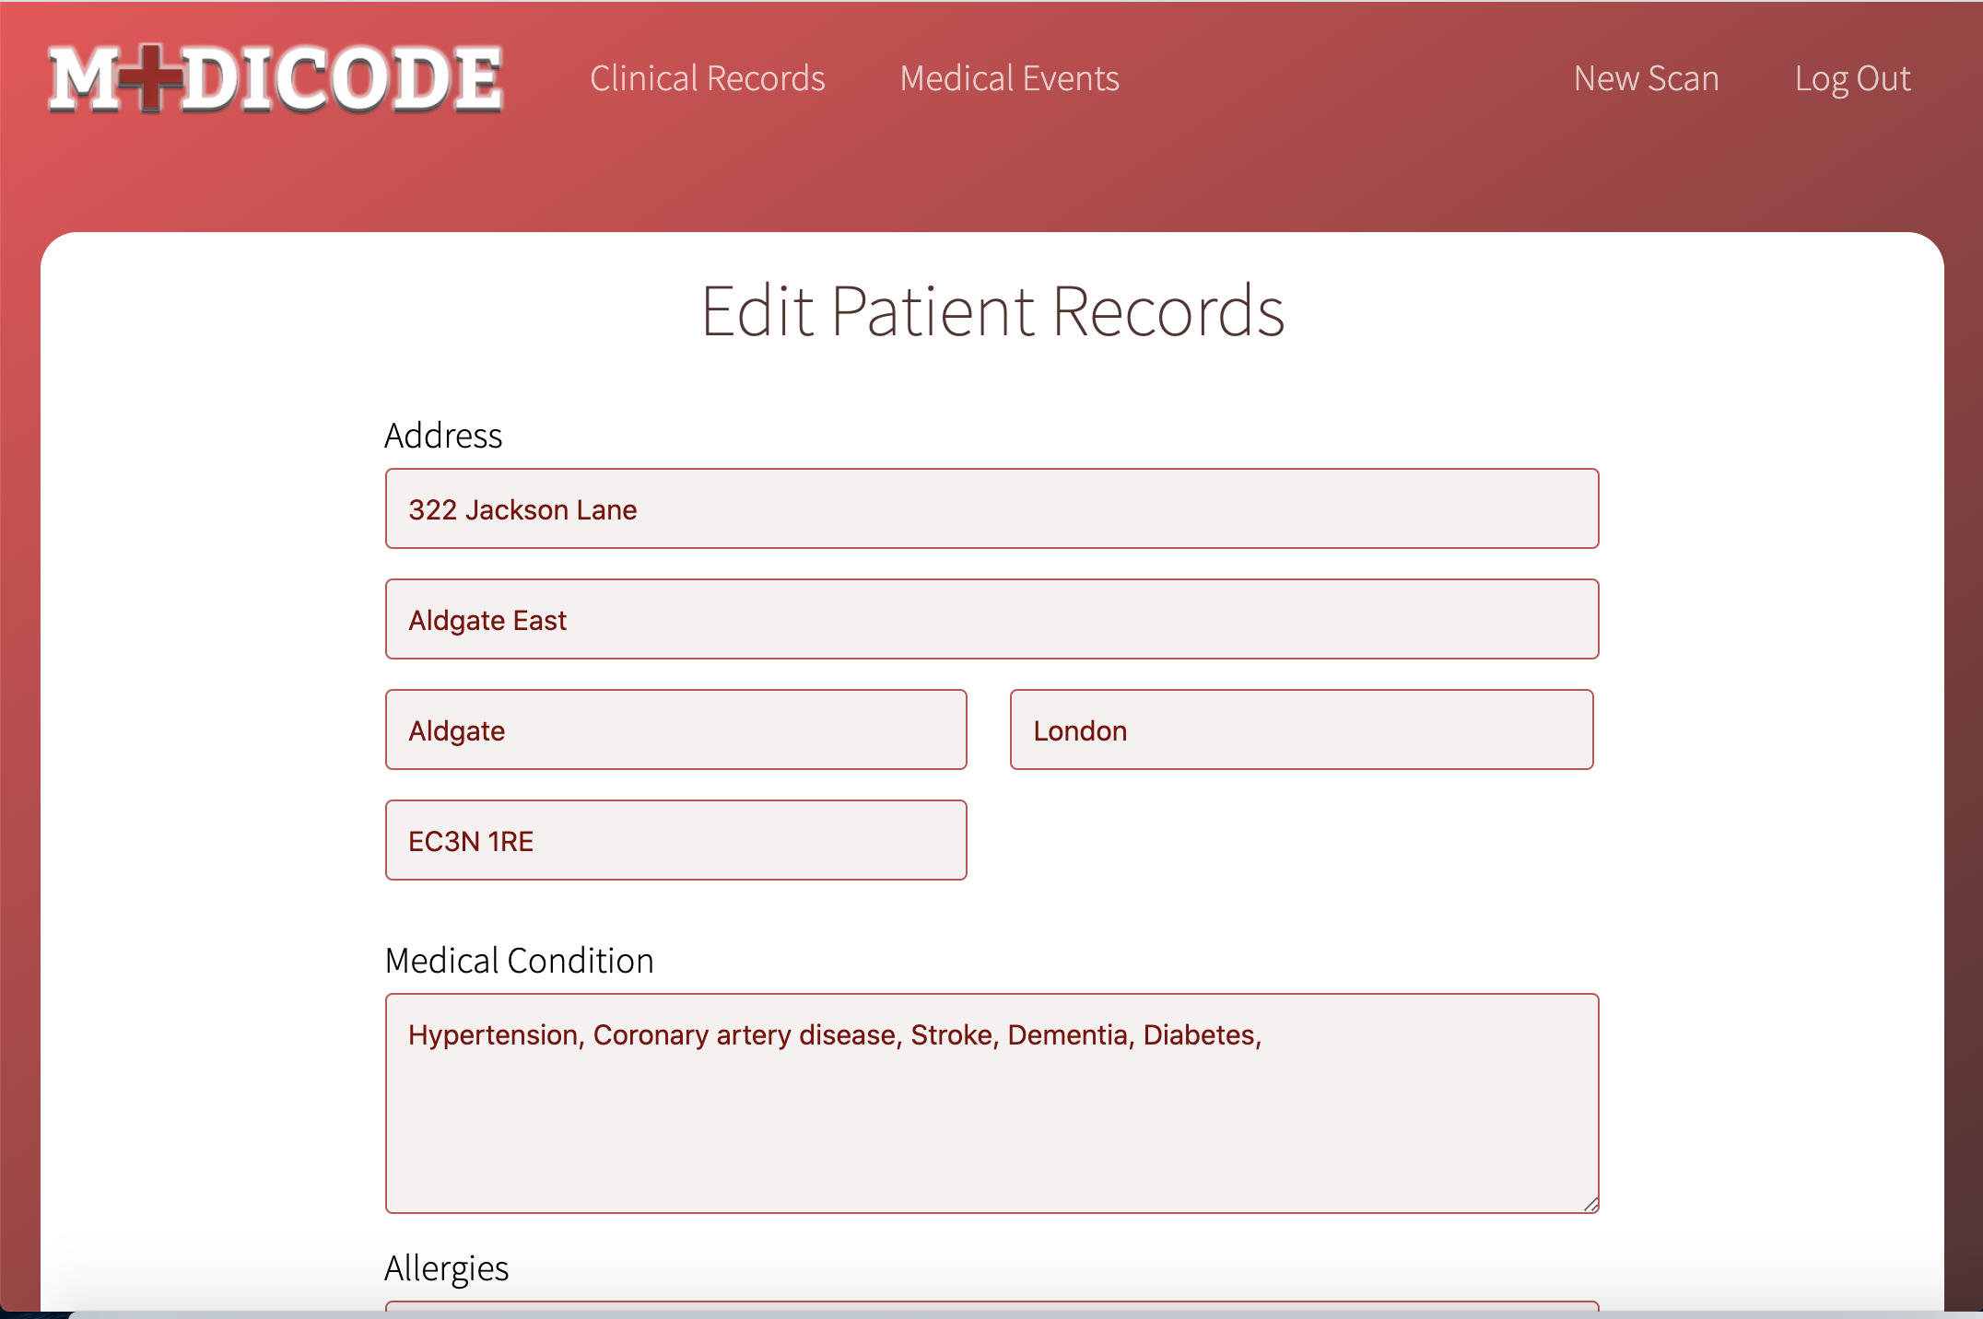
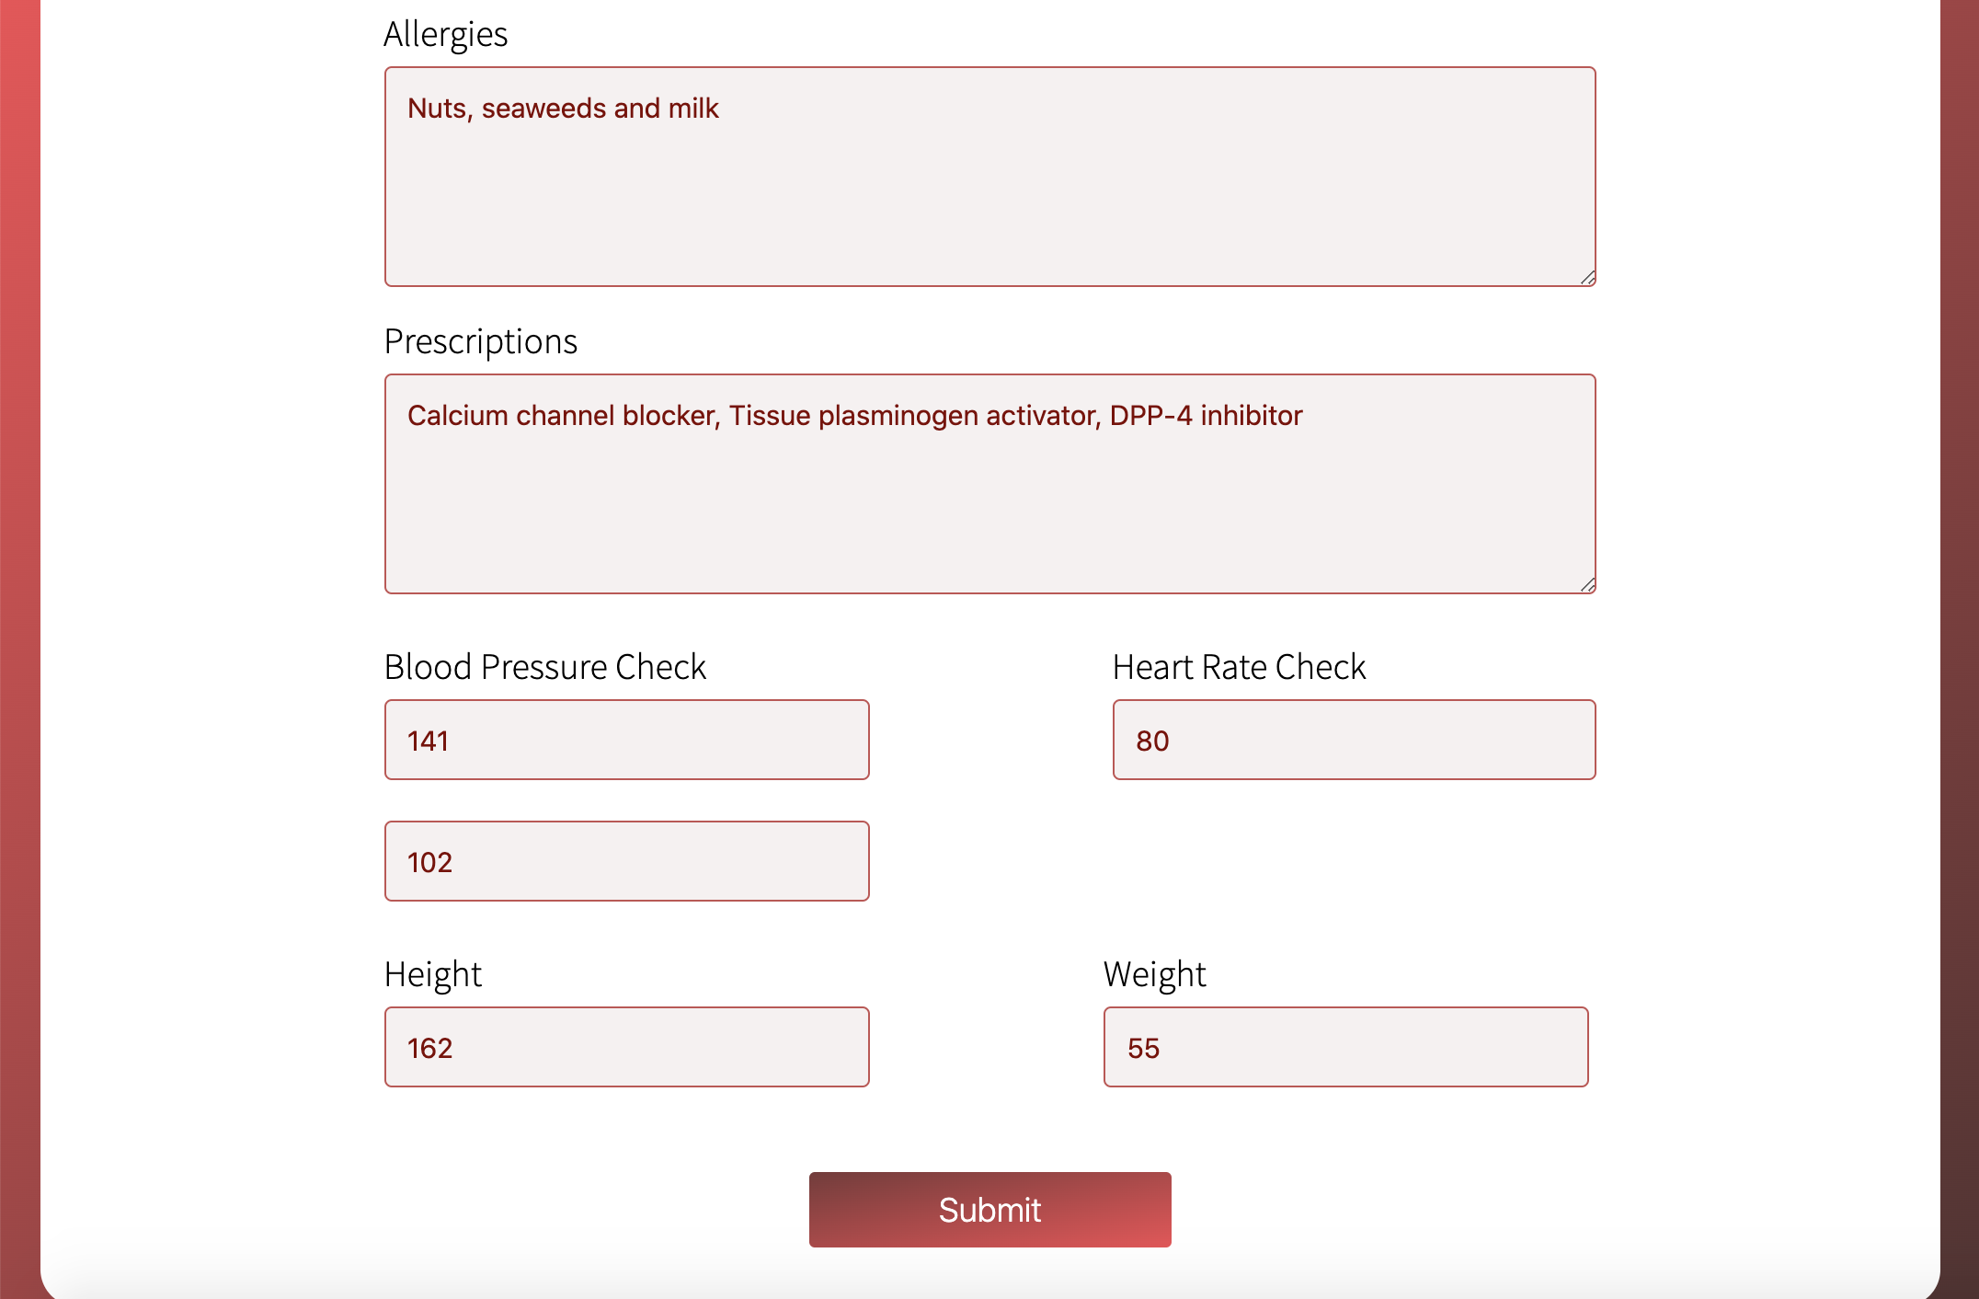
Edit Records Page
Edit Records Page loads a form where each input has already a value of what we are storing in our database.
This way we do not need to fill the form again, we just need to change the value where it is appropriate, then we click on the submit button.
Edited values will be changed in our database, and the rest of data will stay as it was.
After pressing submit button it redirects the user to the patient’s page and reloads the session with the updated data.

Slide 12
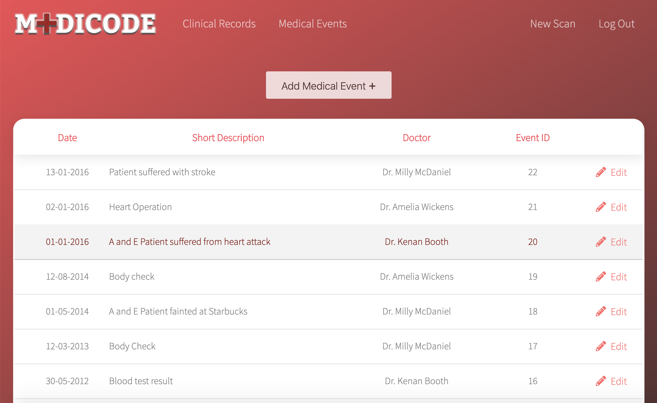
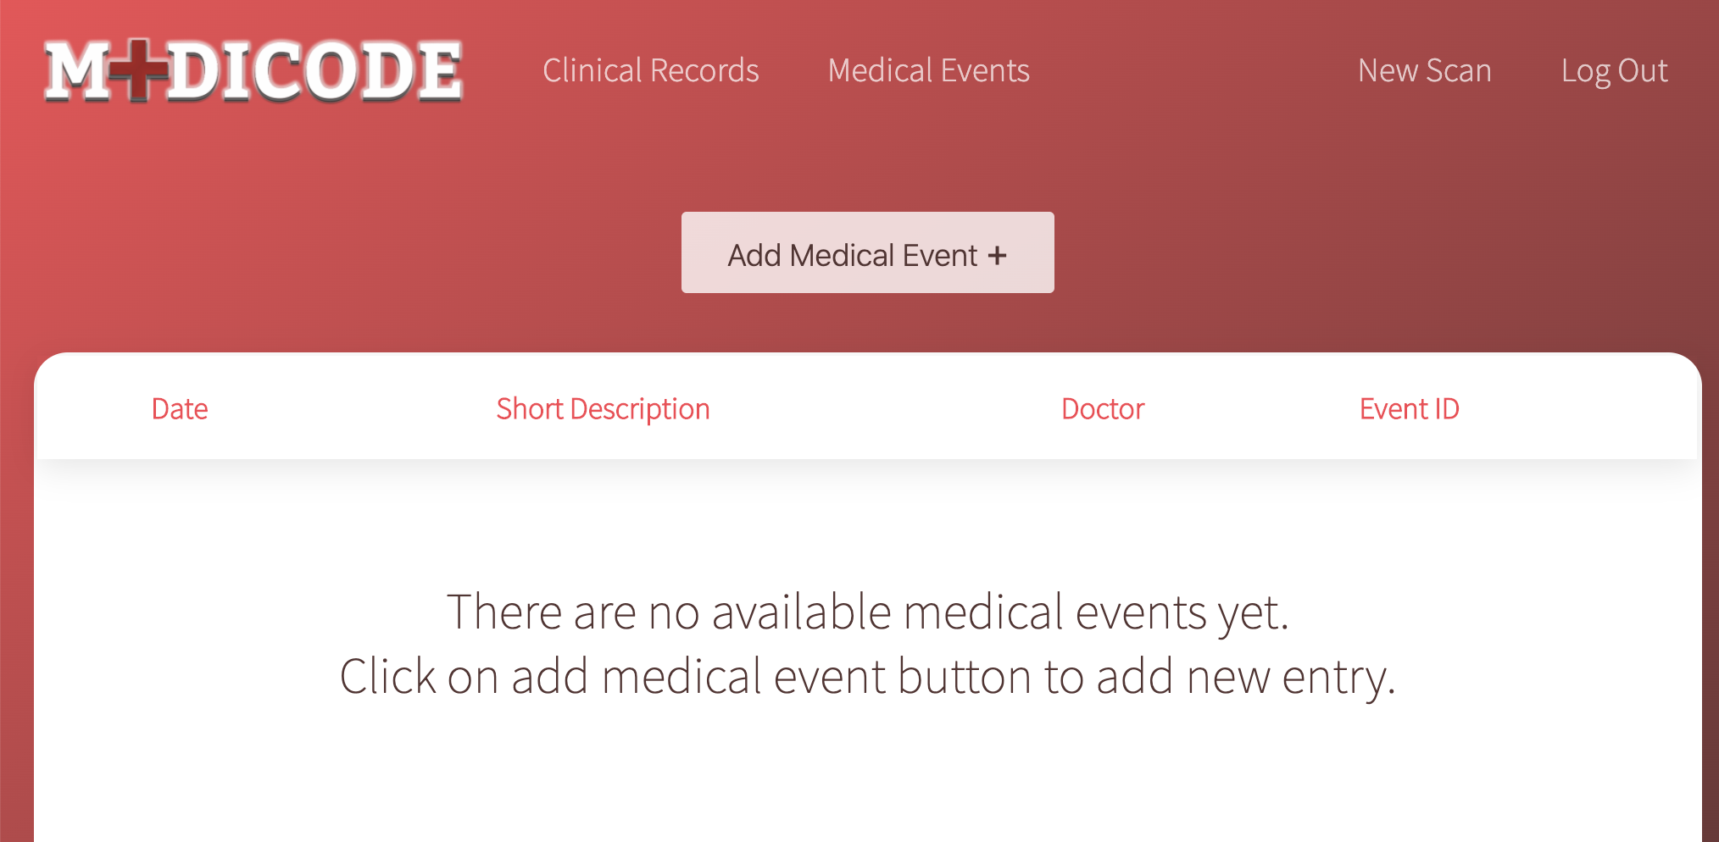
Medical Events Page
By clicking on Medical Events link in the navigation bar or Medical Events button on Patient Page we can render Medical Events Page.
On this page we can see the patient’s whole Medical History in the table.
The table is ordered by date in descending order.
We can also see a short description about the event and the name of the Doctor who threated the patient.
By clicking on one of the events we can see the whole report, or by clicking on edit button we can edit the report.
By clicking on Add Medical Event button we can add new entries to our database.

Slide 13
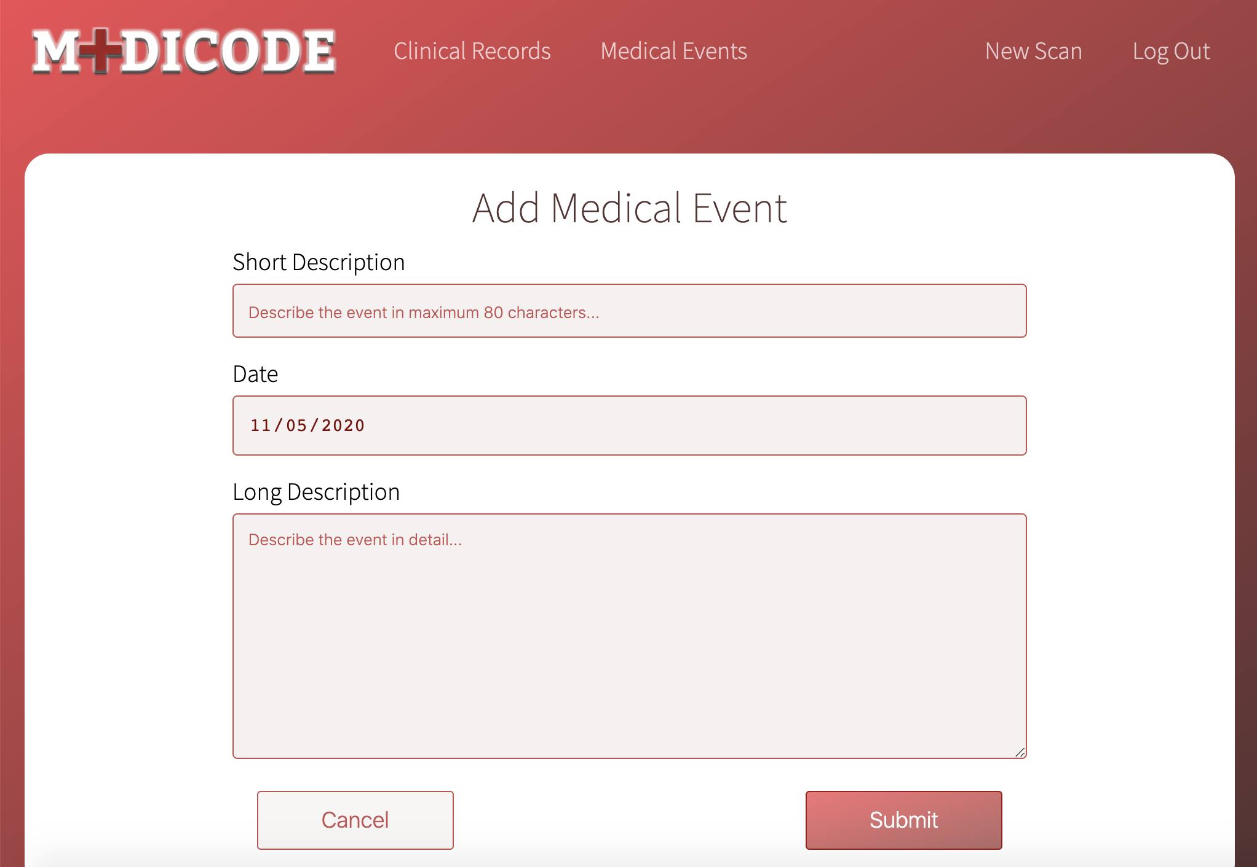
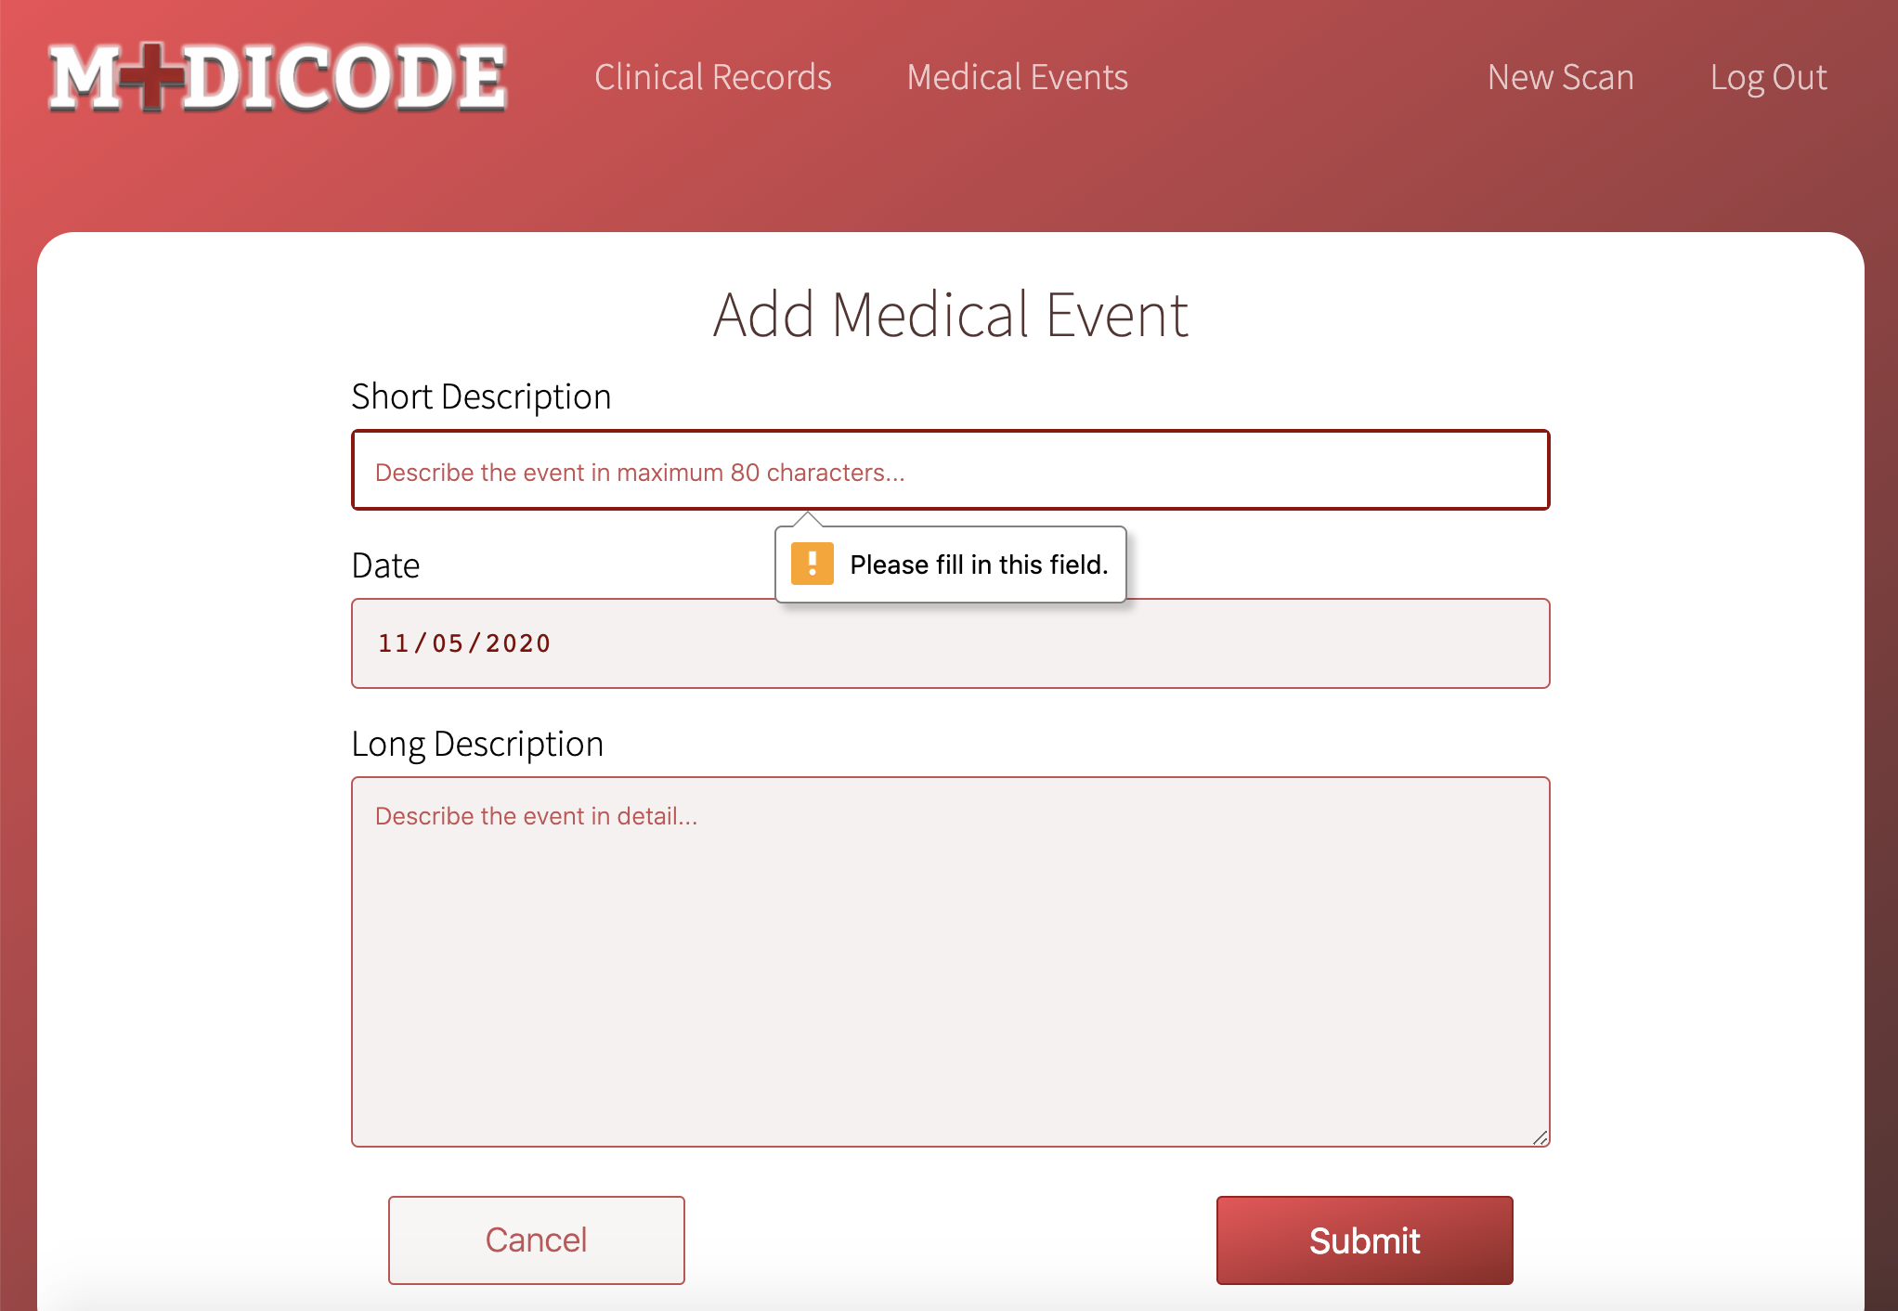
Add Medical Event Page
This is the page where doctors can add new Medical Reports by filling up the form.
Each field must be completed.
For Short Description field there is a character limit which 80 characters user is not able to type more than that.
There is an automatic value for Date which is always the date when it is opened.
We can cancel this process by pressing cancel button.
By pressing Submit button it will be added to the patient’s database and the table will updated with the new event.

Slide 14
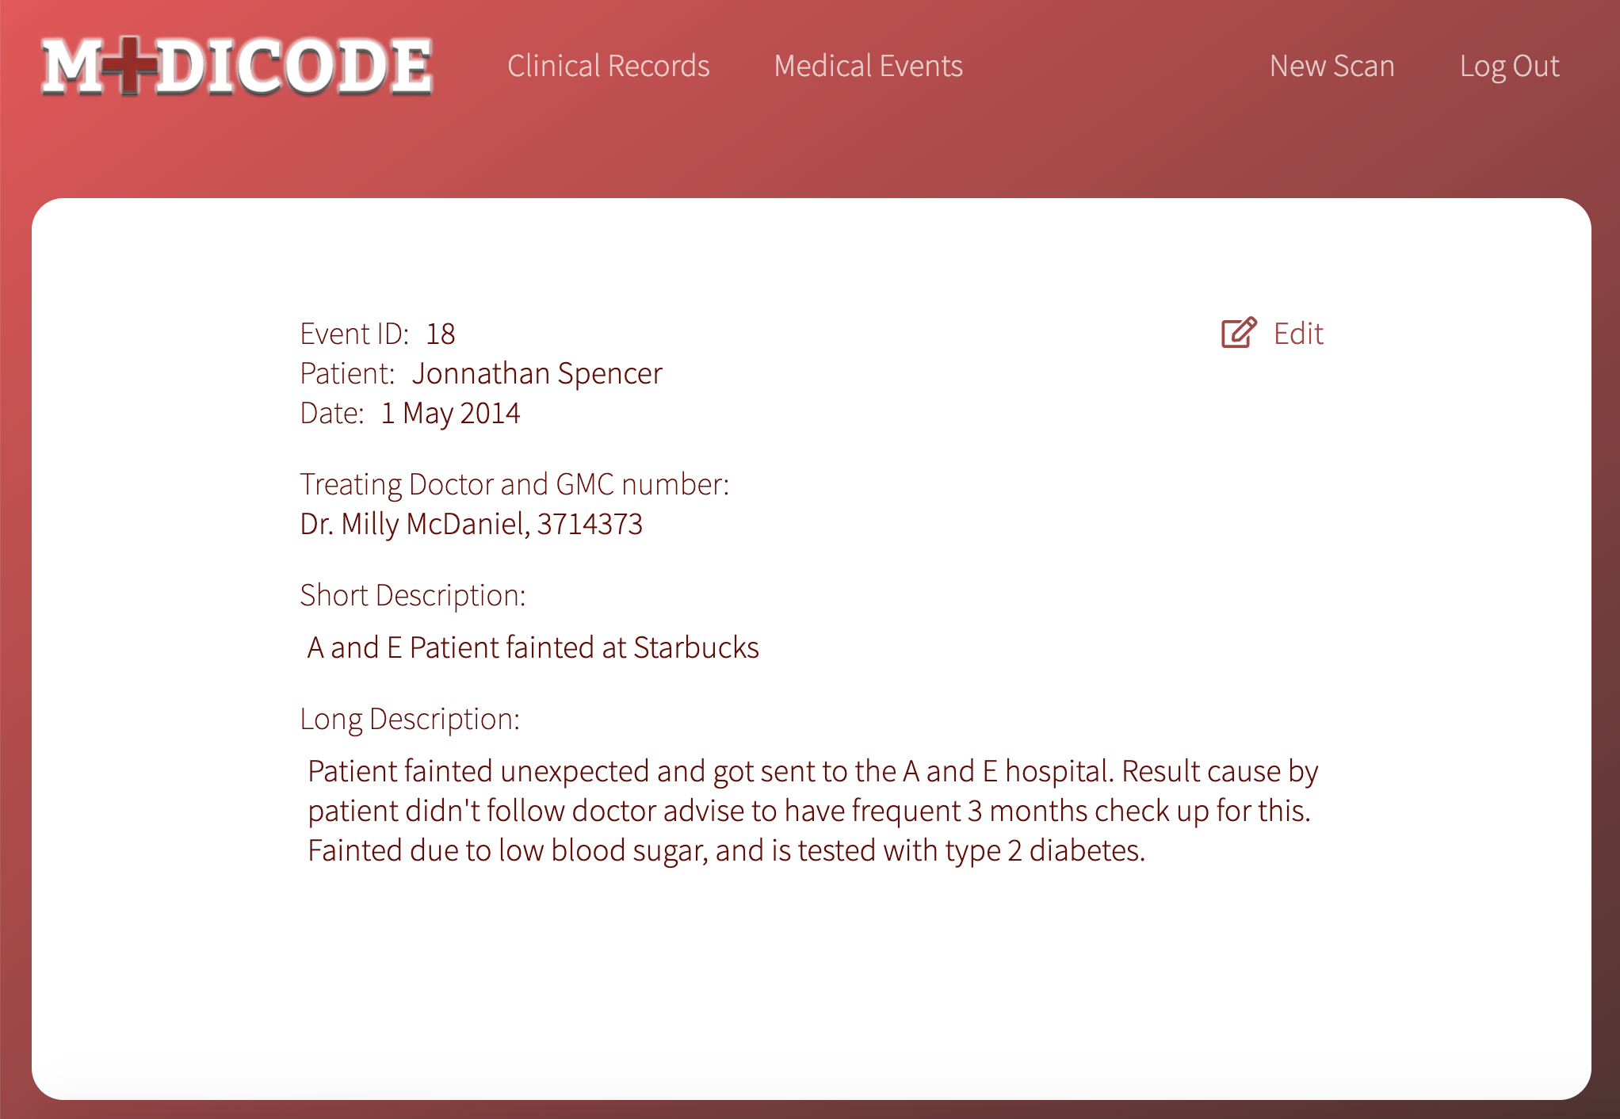
Medical Event Page
By Clicking on one of the rows from table user can view the full report about the medical event.
By clicking on edit button user can edit these reports.

Slide 15
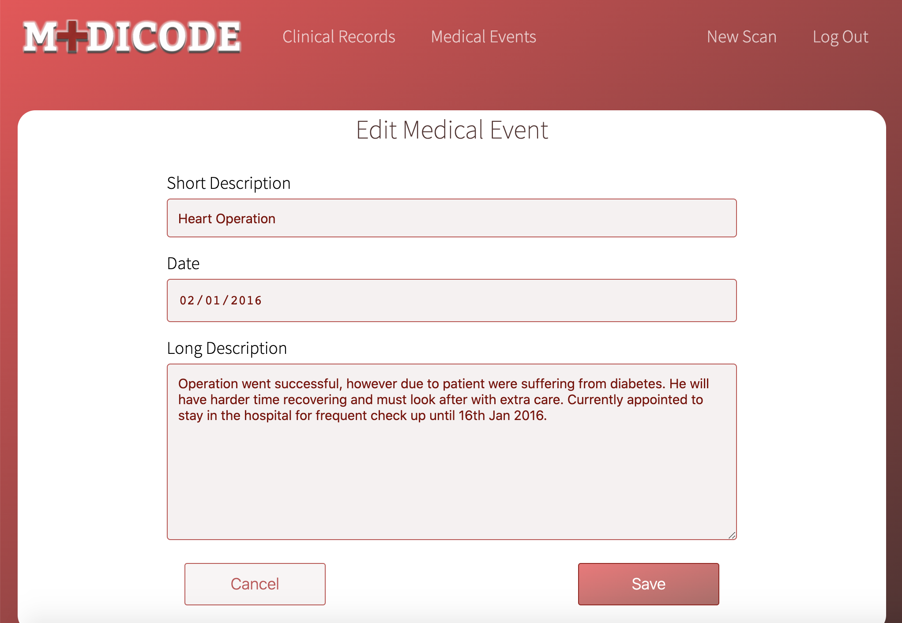
Edit Medical Event Page
Edit Medical Event Page.
By clicking on edit button on the table or on the Medical Event page we can open edit medical event page.
On this page we can make changes to the report and then update in our database.

Slide 16
Android Application
GIT: https://gitlab.doc.gold.ac.uk/softproj09/android_medicode

